Slide 1
Financial Sentiment Analysis
Group-6

Slide 2
Members
Anish
Rishik.S
C Sidharth Santhosh
Vankayalapati Manogna
Gaurav
Vaishnavi S G
Anil Chandrakant Biradar
Dausabgari Shaik Salman Basha

Slide 3
Case Study
Business Objective:
Need to get sentiment analysis of financial statements and gauge its impact i.e. positive, negative or neutral on the business and government.
Data transformation/Text processing using R/Python
Need to get sentiments Analysis and Emotion mining with some charts like histogram, Density plot, Barplot, pie-plot etc.
Deployment through R Shiny or Flask/ Streamlit
Problem Statement:
The goal of this project is to conduct sentiment analysis and emotion mining on financial statements to determine their positive, negative, or neutral impact on both business and government. The project makes use of combined datasets from FiQA and Financial PhraseBank, which are provided in convenient CSV format.

Slide 4
Understanding the given data and domain:
Financial sentiment analysis is the process of evaluating and interpreting sentiments expressed in financial statements to gain valuable insights into market reactions, investor perceptions, and overall financial sentiment. This analysis is distinct from routine sentiment analysis, owing to its emphasis on the financial domain and its specific goals. The project’s goal is to implement an NLP model to address the challenges associated with sentiment classification in the given financial dataset. Using Sentiment analysis to categorize financial statements as positive, negative, or neutral. Using appropriate NLP libraries and techniques for sentiment analysis. Performing emotion mining to gain a better understanding of the emotional context in the financial statements.
Importance of Financial Sentiment Analysis:
Informed Decision-Making:
Allows businesses and investors to make better decisions based on market sentiment.
Provides useful information about the impact of financial statements on market behaviour.
Risk Management:
Identifies potential market fluctuations to help with risk management strategies.
Alerts businesses to emerging issues that may affect financial stability.
Market Perception:
Provides an insight into investor perceptions and sentiments towards financial investments.
Allows for adjustments to marketing strategies based on market sentiment trends.

Slide 5
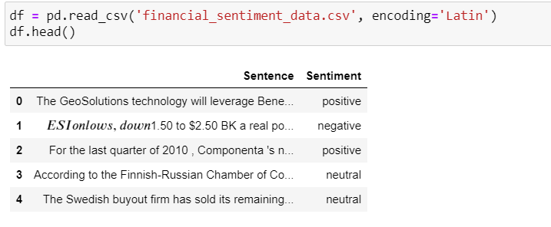
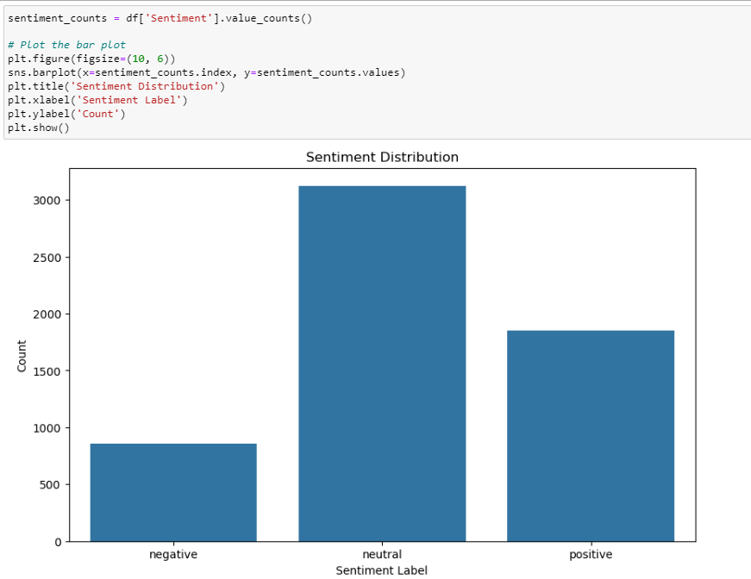
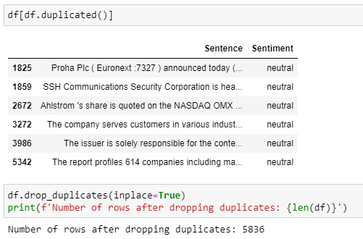
Data Cleaning, Preprocessing, Exploratory Data Analysis
Removing Duplicates
Insights:
This analysis determines whether the data in the given dataset is balanced or imbalanced for the Sentiment feature.
From the above distribution we can see that neutral sentiment have more data points than positive and negative sentiments.

Slide 6
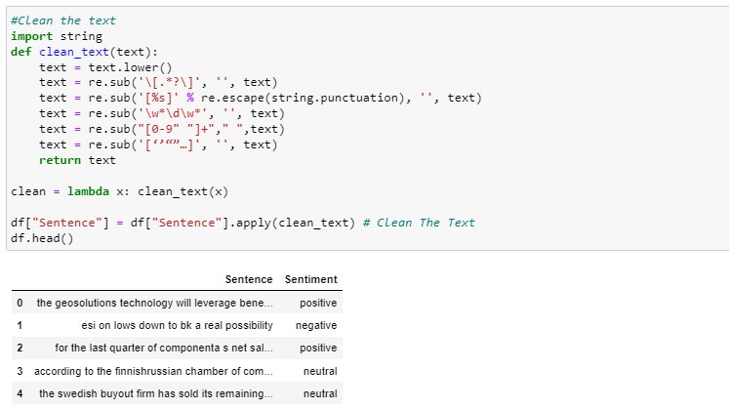
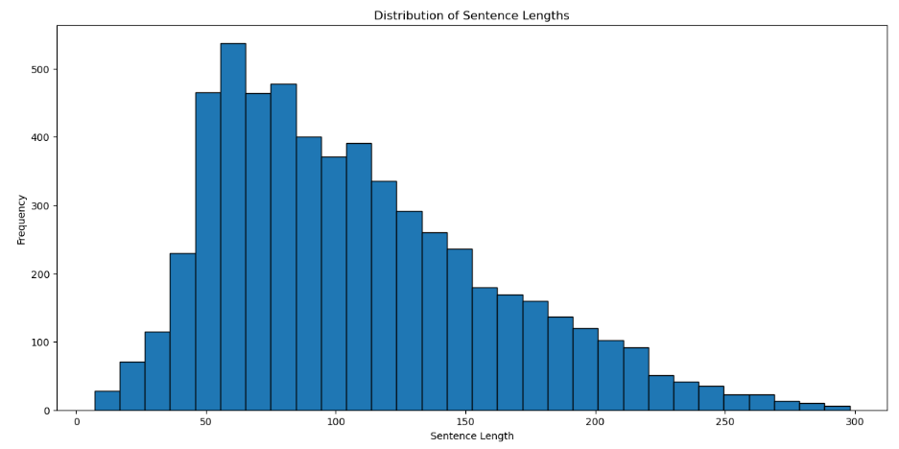
Cleaning the Sentences
Distribution of Sentence lengths
The above function is used to remove Special characters from the sentences and converts the sentence into lower case
Insights:
The above histogram shows the distribution of sentence lengths in a dataset.
The most frequent sentence length is between 10 and 20 words.
There are a few sentences that are more than 250 words long.

Slide 7
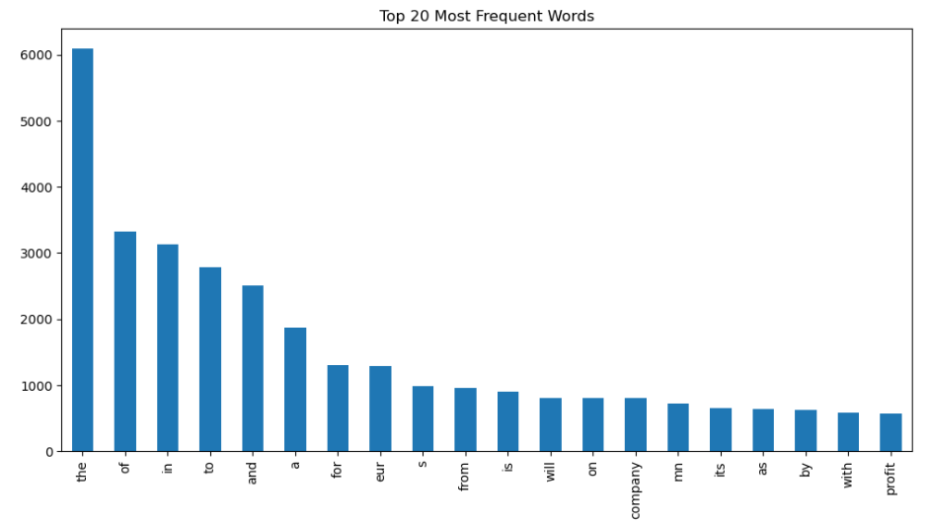
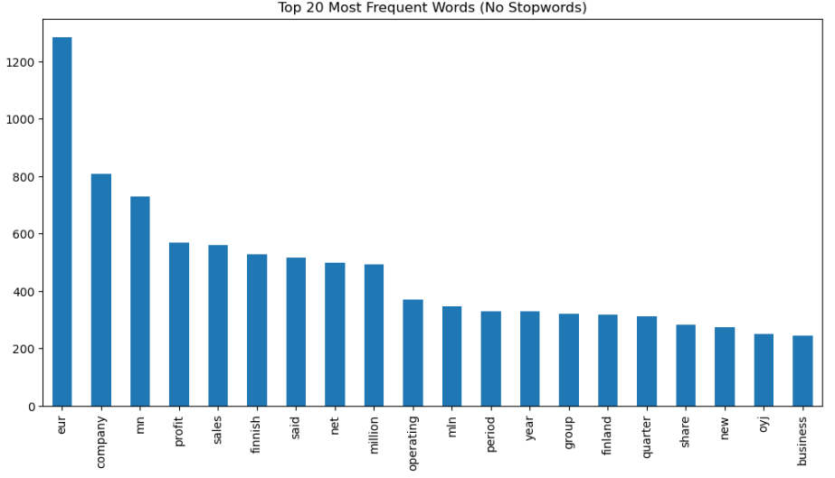
Visualization of Frequency before removing stopwords
Visualization of Frequency after removing stopwords
Insights:
The most commonly used word is "the", followed by "of", "to", "and", "a", "for", "eur", "from", "is", and "will".
These are all common stop words, which are usually removed from text analysis because they have no meaning on their own.
Once stop words are removed, the most frequently used words are likely to be more informative and relevant to the dataset.
The word "eur" remains the most frequently used, followed by "company", "million", "operating", "business", "net", "profit", "financial", "year", and "group".
As assumed, financial terms become much more prominent than they were prior to the removal of stopwords.
The words "said" and "first" appear more frequently, which may indicate the presence of financial news or reports, as well as specific timeframes mentioned in the data.

Slide 8
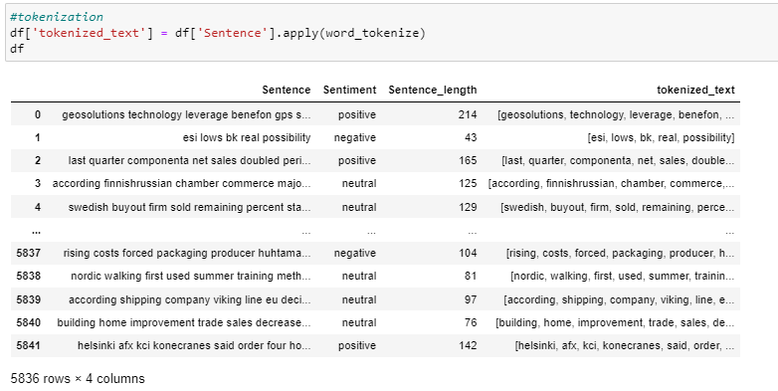
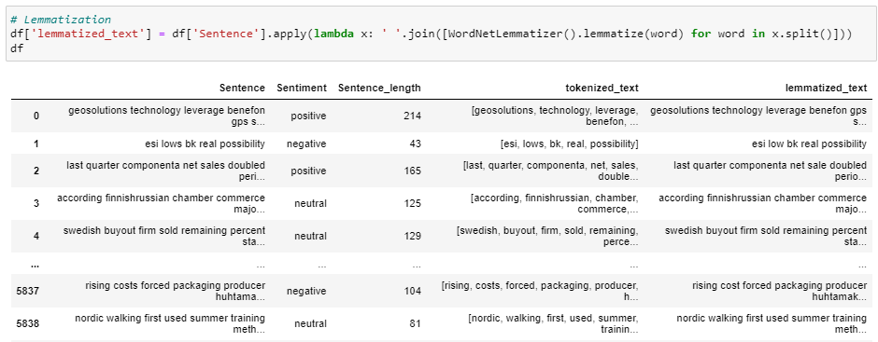
Tokenization
Lemmatization
Tokenization is the process of breaking down a text into smaller units called tokens.
The result of applying word_tokenize to each sentence in the Sentence column is stored in a new column called tokenized_text.
The specific output of the code will depend on the contents of the Sentence column.
Lemmatization is the process of reducing words to their base or root form, resulting in a valid word.
It use the WordNetLemmatizer class from the nltk library.
It splits each sentence in the Sentence column into words with .split() and then applies the .lemmatize(word) function to each word.
The lemmatized words are then joined back together using .join() and saved in a new column called lemmatized_text.

Slide 9
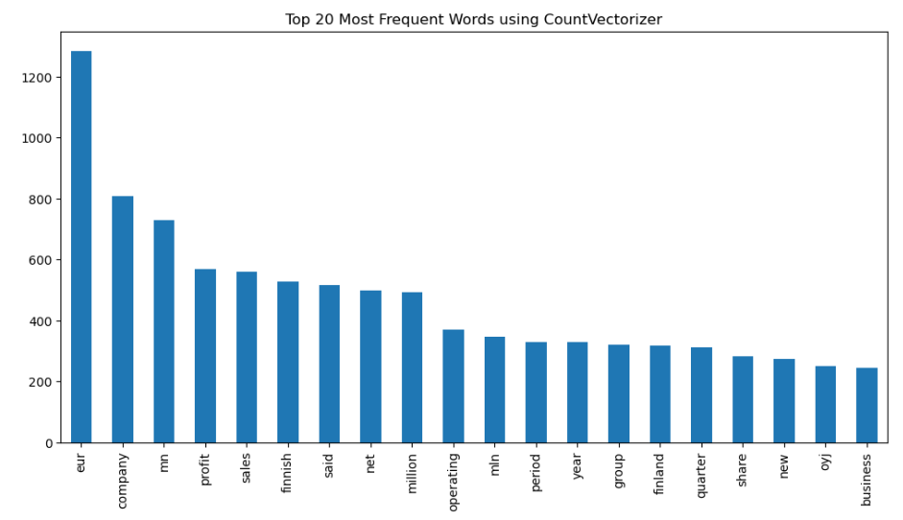
Visualization for Frequency using CountVectorizer
Insights:
Using CountVectorizer, the visualization displays the most frequently occurring words in the text data.
The specific words and frequencies may differ depending on the size and content of the dataset used.
This visualization gives a quick overview of the most common words in the data, but it may not include all of the relevant information.

Slide 10
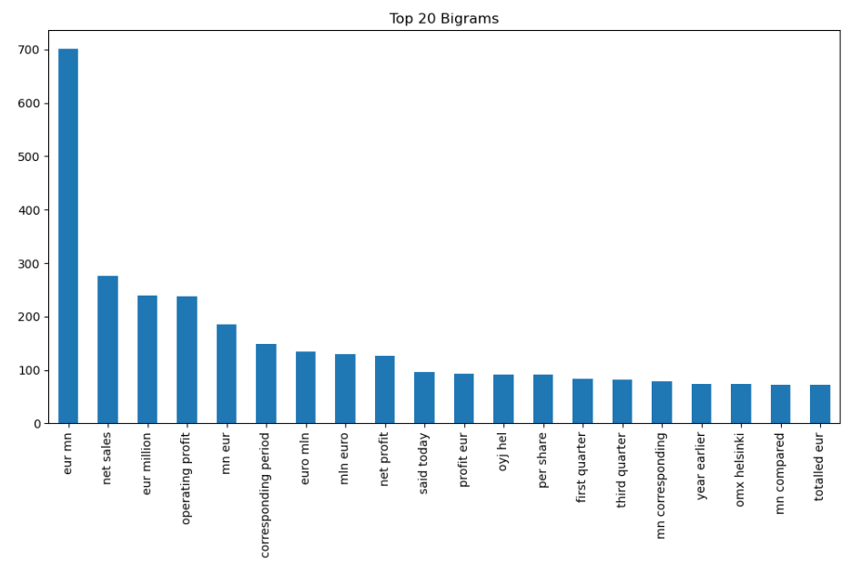
Visualization of Bigram
Insights:
The visualization shows the frequency of bigrams, or pairs of adjacent words, in a given dataset or text.
It allows for the identification of trends in the language usage, showing which word pairs occur most frequently in the analyzed text.
The visualization highlights common phrases or pairs of words, providing insights into prevalent language patterns and visually representing the occurrence of specific word pairs within the dataset.

Slide 11
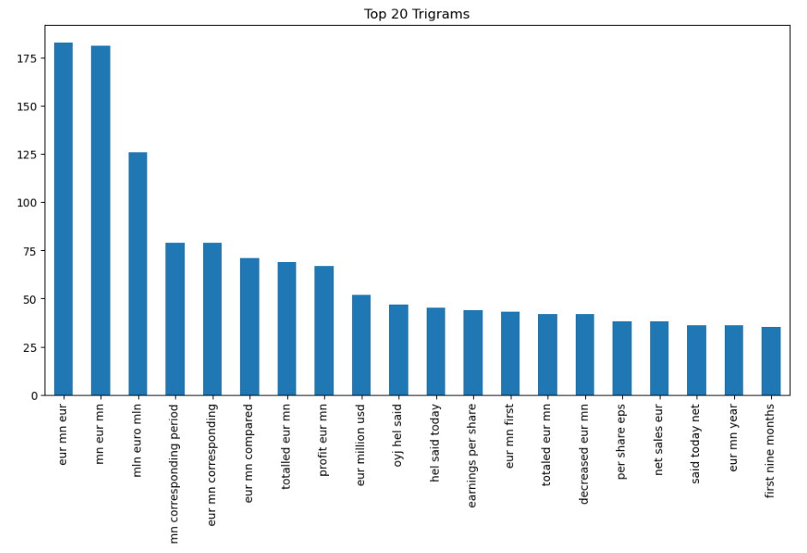
Visualization of Trigram
Insights:
The visualization depicts the frequency of the Trigram or sequences of three adjacent words, within the analyzed dataset or text.
The visualization provides statistical insights into the co-occurrence of specific word sequences, which can be valuable for linguistic analysis and language processing.

Slide 12
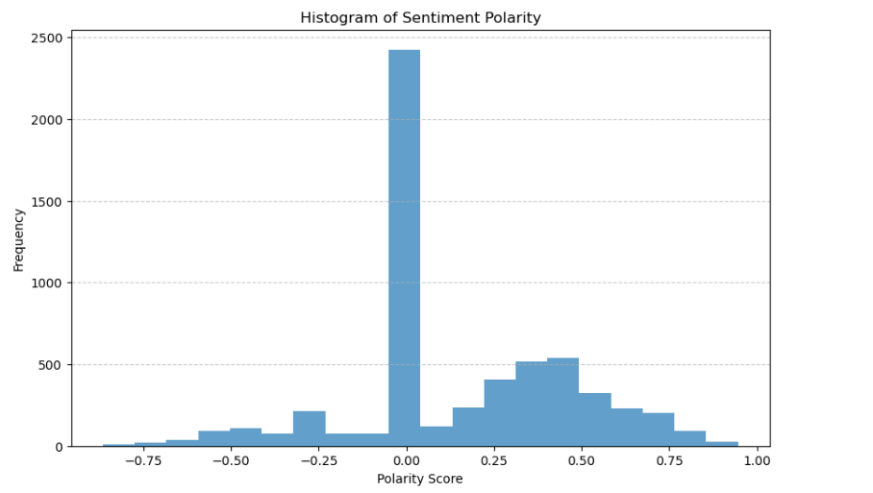
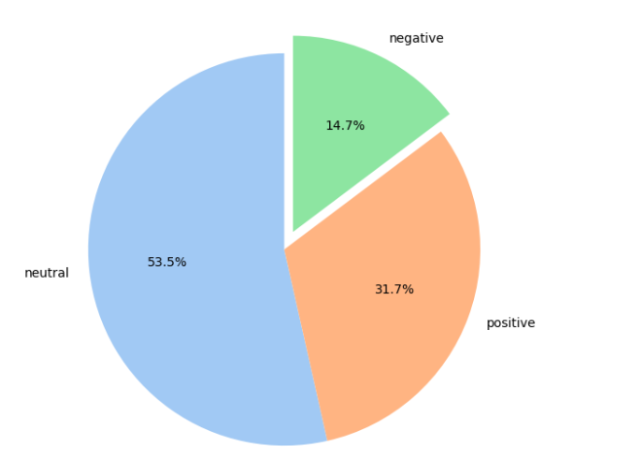
Insights:
The above pie-chart shows the percentage of people who responded positively, neutrally, and negatively.
31.7% of the respondents had a positive sentiment. 53.5% of the respondents had a neutral sentiment. 14.7% of the respondents had a negative sentiment.
The histogram shows the distribution of sentiment polarity scores.
The sentiment polarity scores are evenly distributed between -1 and 1.
There is a slight peak in the positive sentiment polarity scores around 0.25.

Slide 13
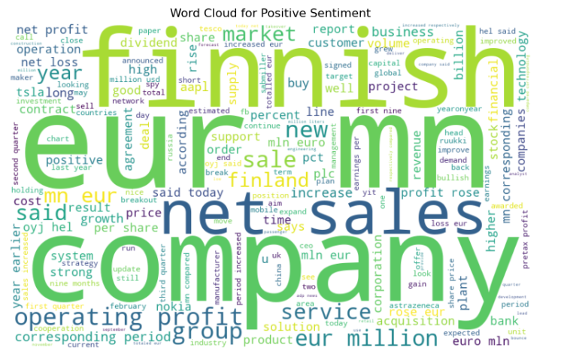
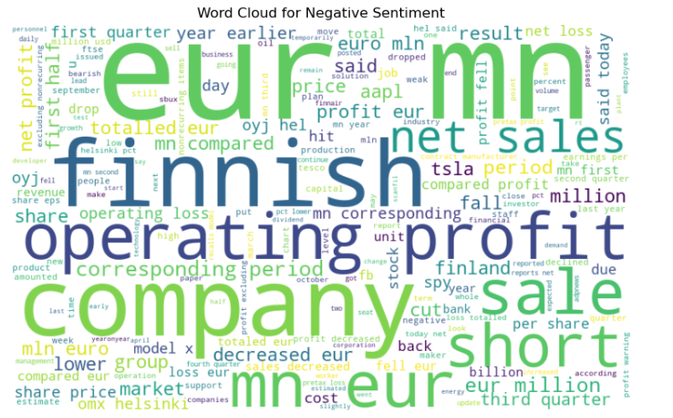
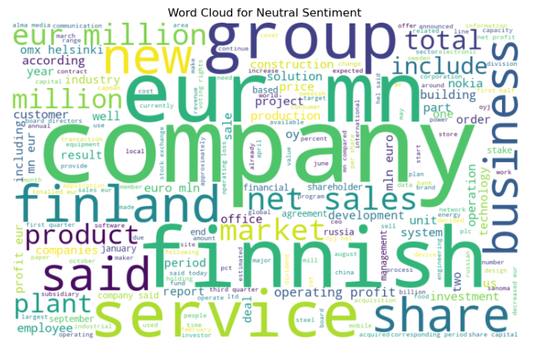
WordCloud Representation for positive, negative, and neutral sentiment

Slide 14
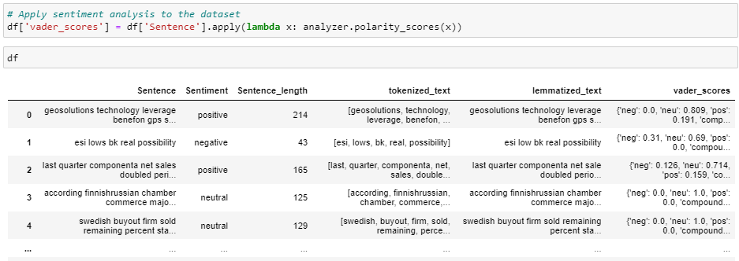
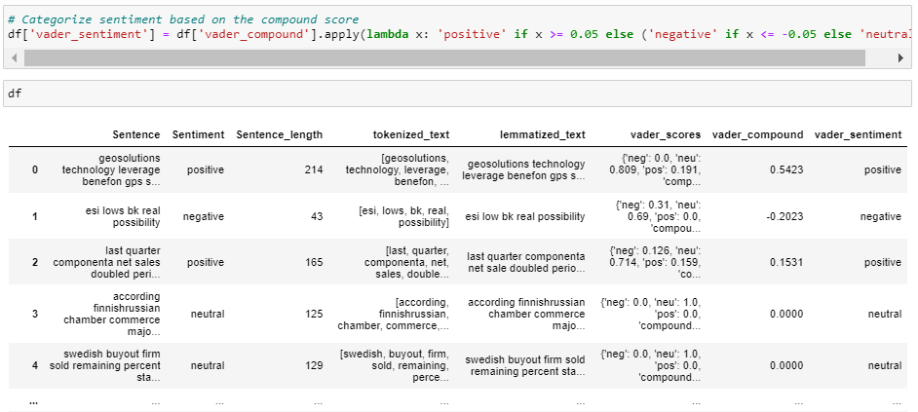
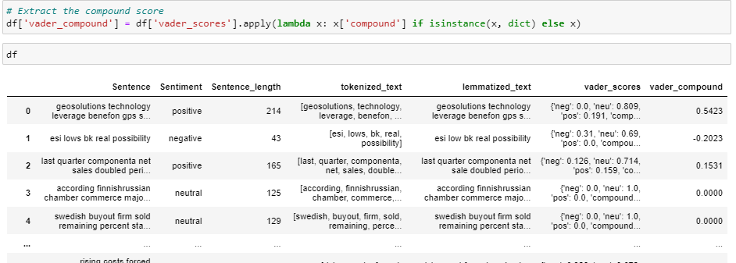
Sentiment Analysis
Finding Vader scores
Categorize the sentiment using compound score
Extracting the Compound scores for each sentence

Slide 15
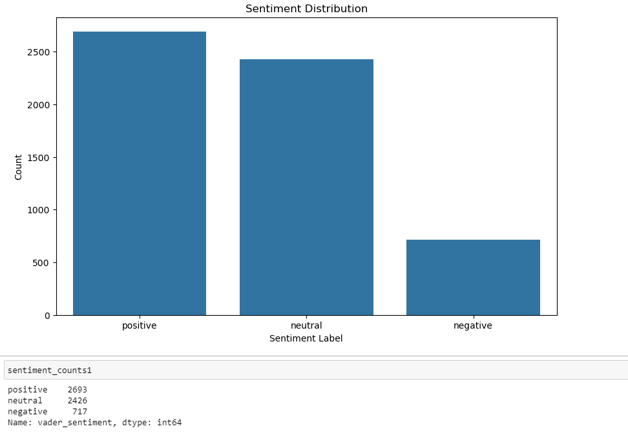
Distribution of Sentiment analysis using Vader
Insights:
After using Vader for Sentiment analysis, The distribution is roughly equal between positive, neutral, and negative sentiment. There are a total of 2693 positive sentiment labels, 2426 neutral sentiment labels, and 717 negative sentiment labels.

Slide 16
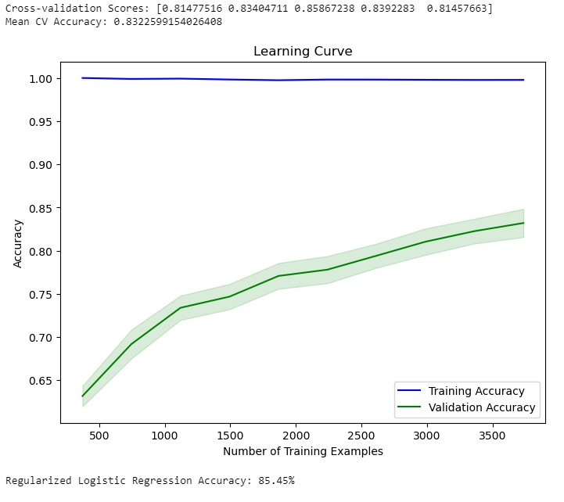
Insights:
The learning curve shows that the accuracy of the model increases as the number of training examples increases.
The validation accuracy is lower than the training accuracy.
There is a significant gap between the training accuracy and the validation accuracy.

Slide 17
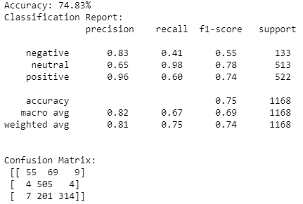
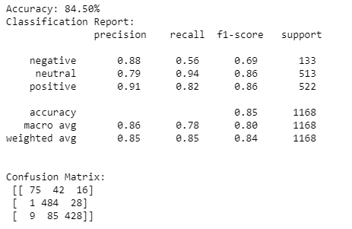
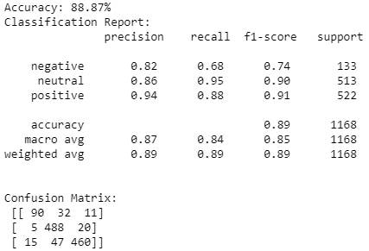
Classification Report
Adaboost Report
Logistic Regression Report
Decision Tree Report

Slide 18
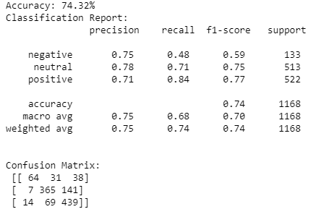
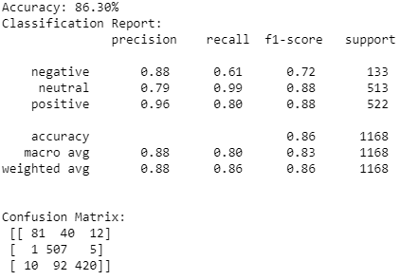
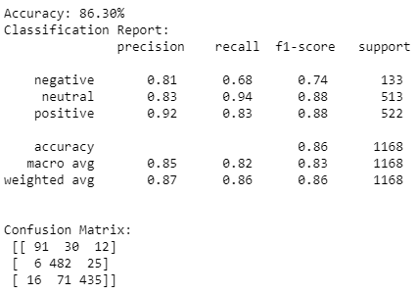
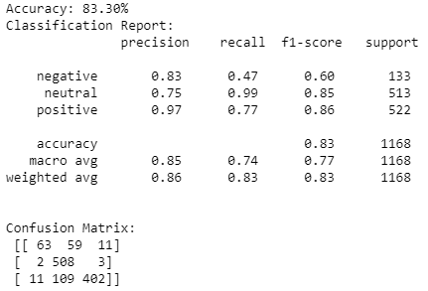
Classification Report
Naive Bayes Report
Random Forest Report
SVM Report
XGBoost Report

Slide 19
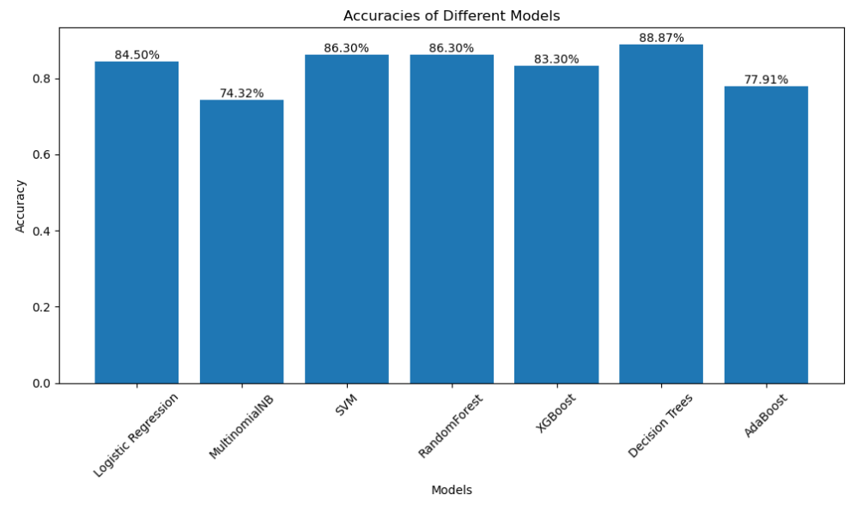
Accuracies before Hyper Parameter Tuning
Insights:
After building the various models the accuracies are visualized using barplot. These accuracies are visualized before performing Hyper Parameter Tuning

Slide 20
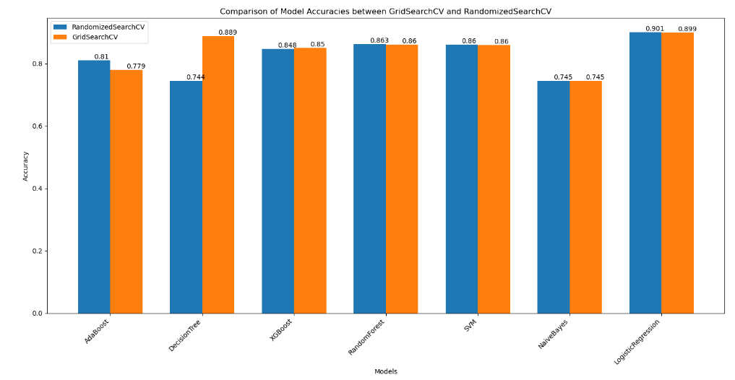
Accuracies after Hyper Parameter Tuning
Insights:
To increase the accuracies we performed Hyper Parameter Tuning using GridSearchCV and RandomizedSearchCV from the visualization we can conclude that Logistic Regression having highest accuracy using RandomizedSearchCV

Slide 21
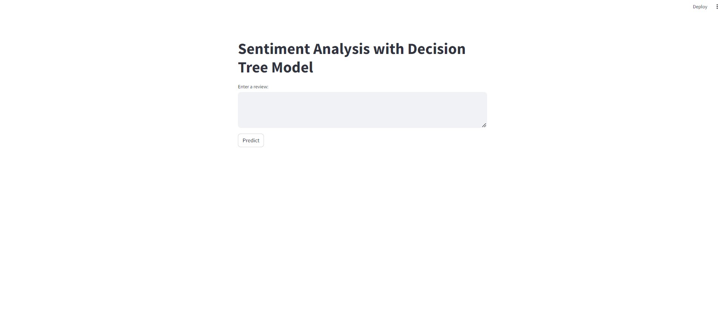
Sentiment Analysis App

Slide 22
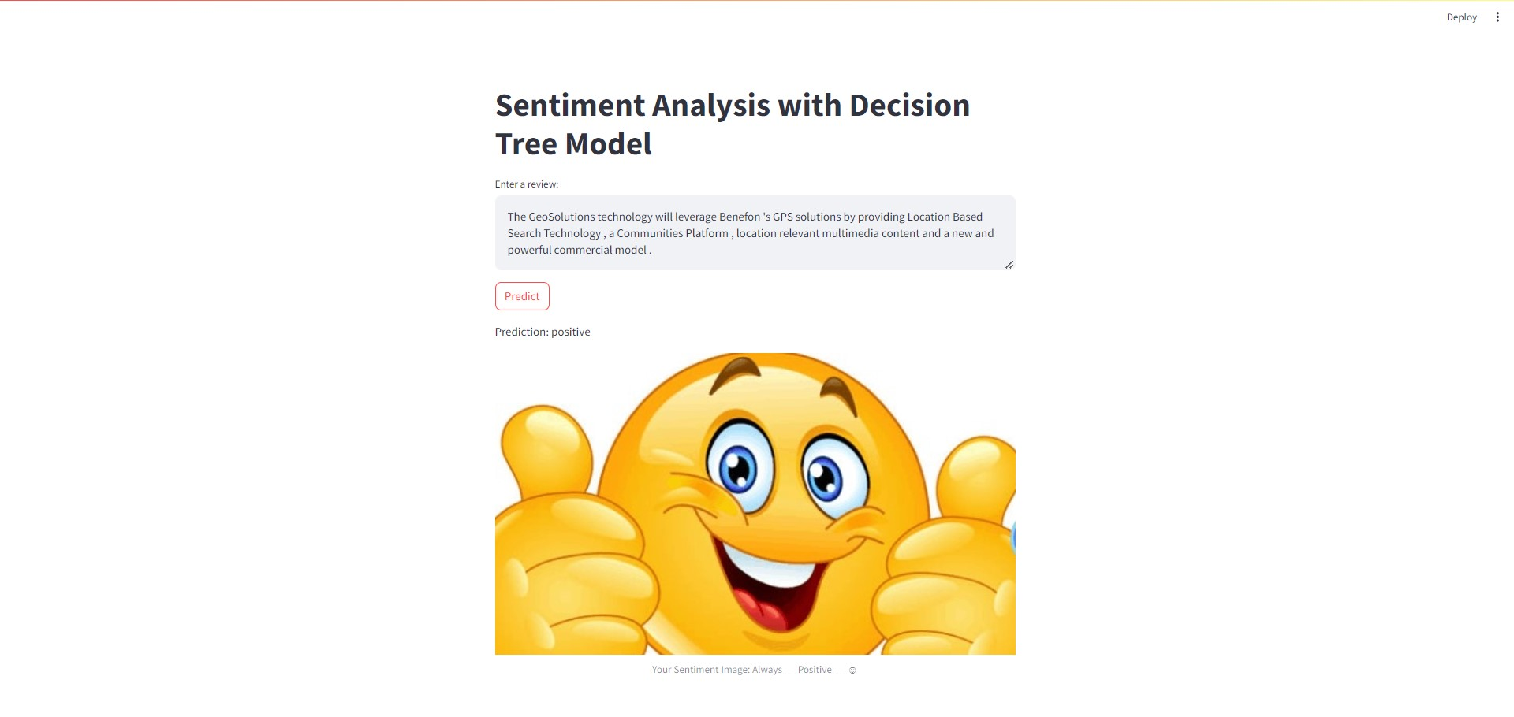
Positive Sentiment

Slide 23
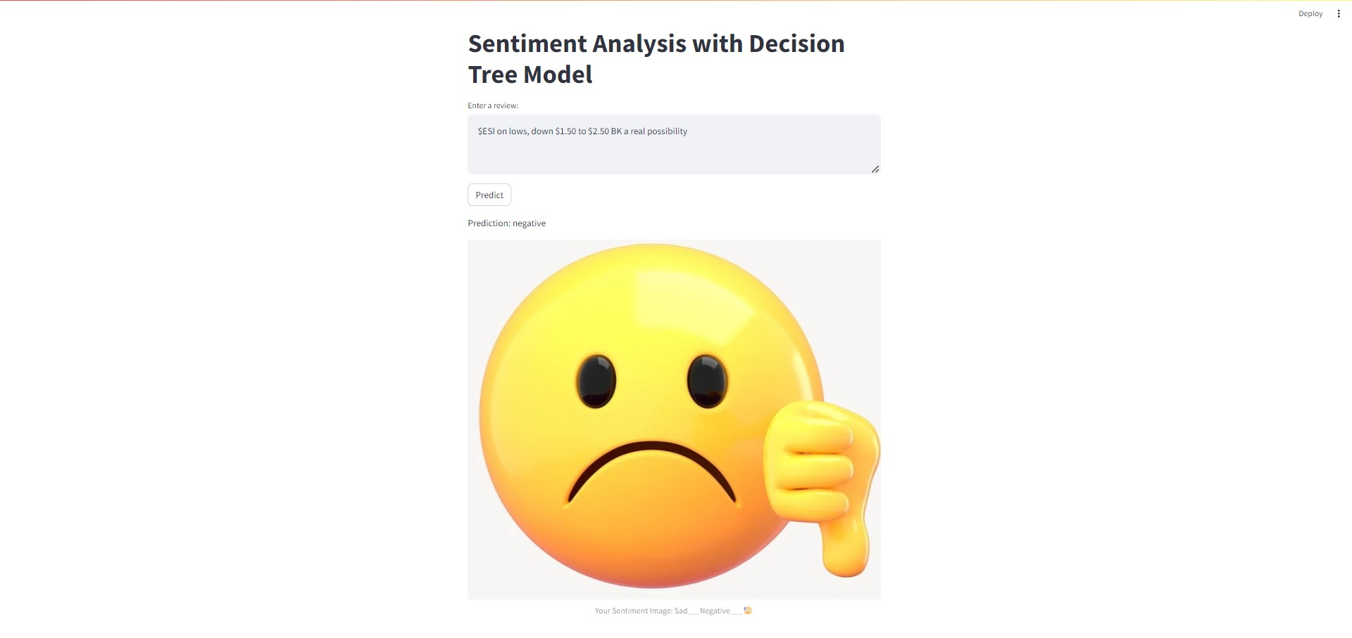
Negative Sentiment

Slide 24
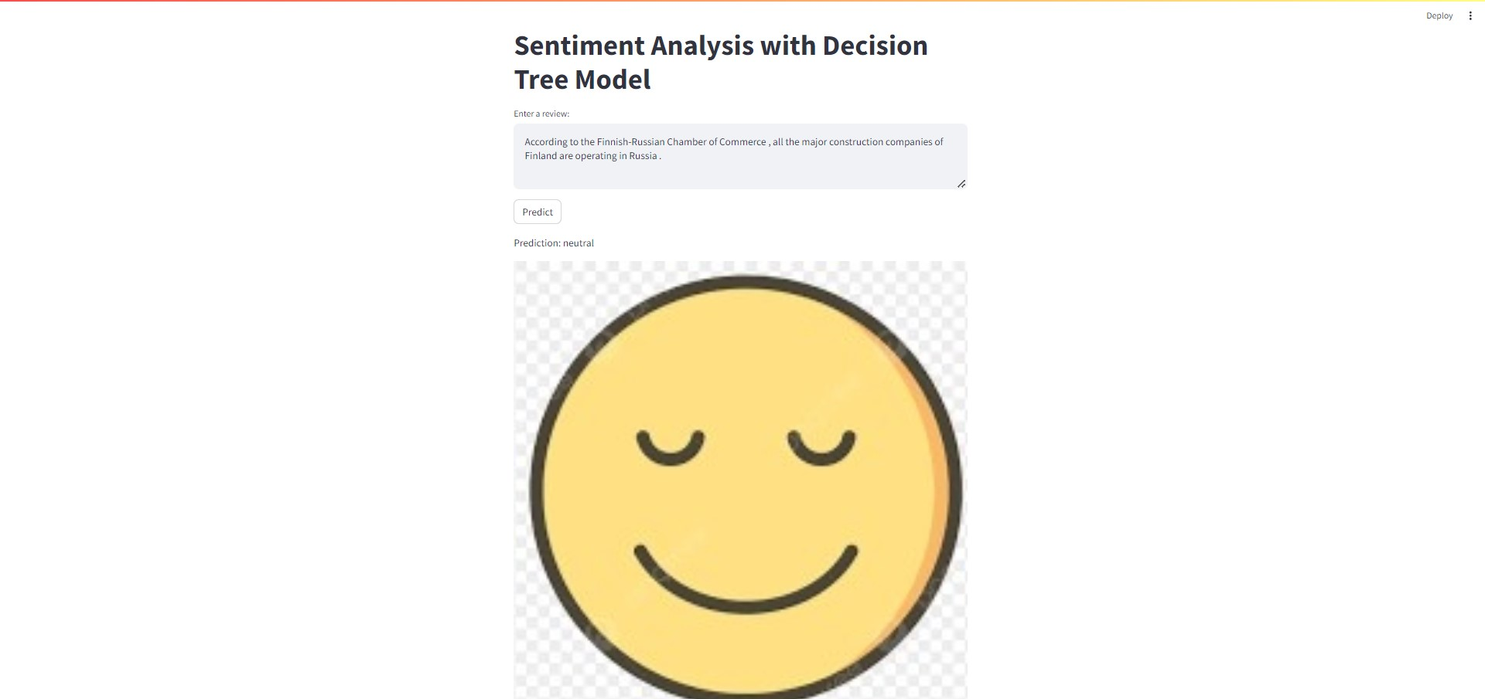
Neutral Sentiment

Slide 25
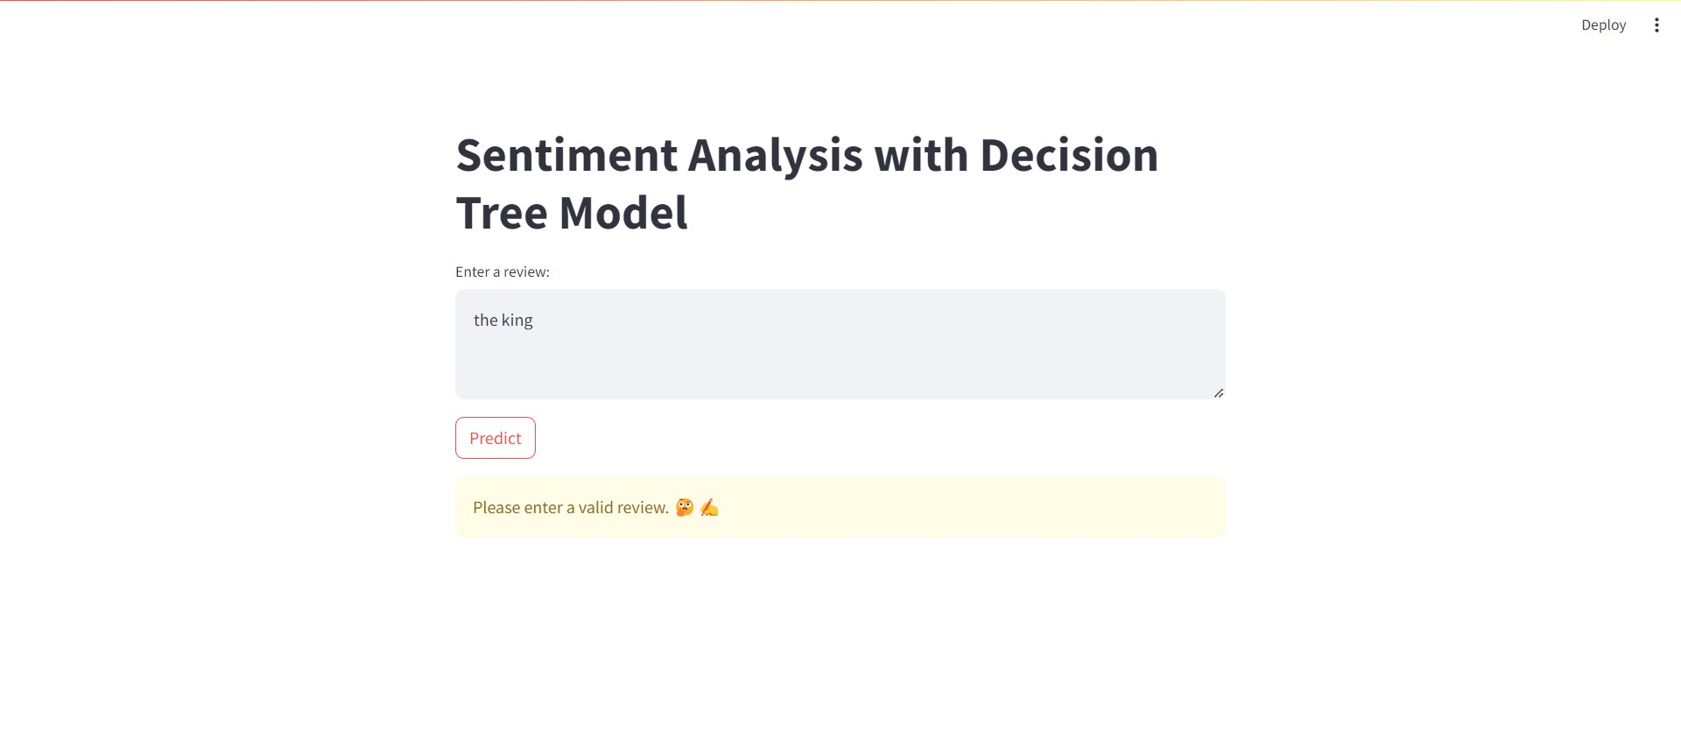

Slide 26
Thank you

